Slide 1

FAKE NEWS CLASSIFICATION USING MACHINE LEARNING
ADS509 - Applied Text Analysis
Subtitle: Technical Overview
Presenter Names: Mohammad Mahmoudighaznavi | Ruddy Simonpour
Date: 10/18/2023

Slide 2

INTRODUCTION
Importance of Detecting Fake News
Utilizing Diverse Models for Classification:
Incorporation of Topic Modeling:
Ensuring accuracy and trustworthiness in the information ecosystem.
Combating misinformation which can lead to societal discord and misinformation.
Upholding journalistic standards and integrity in digital media.
Uncovering prevalent themes and topics within the dataset to better understand the nature of the content.
Enriching the feature set for classification models by incorporating topic-related insights.
Exploring the potential correlation between certain topics and the likelihood of misinformation.
Application of Deep Learning models to capture complex patterns in text data.
Employment of Classical Algorithms for a computationally efficient and interpretable approach.
Comparative analysis to gauge the effectiveness and suitability of different models for the task.

Slide 3










PROJECT JOURNEY
#3 Data Cleaning
#7 Classical Algorithms Modeling
#11 Topic Modeling
#1 Business Objective
#5 Data Pre-processing, Text Tokenizing
#9 Web Scraping Aljazeera News
Share and Use
#4 EDA Processing
#8 Model Evaluation
#2 Gather Data from Kaggle to Train Various Models
#6 Deep Learning Modeling
#10 Deploy Top Model on Aljazeera News for News detection

Slide 4


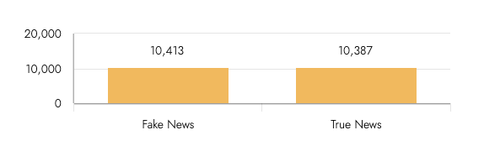
DATA STRUCTURE
Data Preparation and Structure
ID
Title
Author
Text
Label
Data Source:Dataset acquired from Kaggle, encompassing 20,800 entries across 5 columns.
1
House Dem Aide: We Didn't Even See Comey's Let.....
Darrell Lucus
House Dem Aide: We Didn't Even See Comey's Let.....
1
Data Structure:Initial dataset composed of 5 columns: Title, Author, Text, ID, and Label.Label: Target variable indicating 'real' or 'fake' news.Other Columns: Independent variables containing article attributes.
2
FLYNN: Hillary Clinton, Big Woman on Campus
Daniel J. Flynn
Ever get the feeling your life circles the route....
0
3
Why the Truth Might Get You Fired
Consortiumnews.com
Why the Truth Might Get You Fired October 29, ...
1
Data Cleaning:Removal of unnecessary columns to streamline the dataset for analysis.Handling missing values by filling 'NaN' entries in 'Title' and 'Text' columns with empty strings, ensuring smooth text processing.
Class Balance Assessment:Ensured a well-balanced dataset to prevent model bias, paving the way for effective learning across both 'real' and 'fake' news classes.

Slide 5
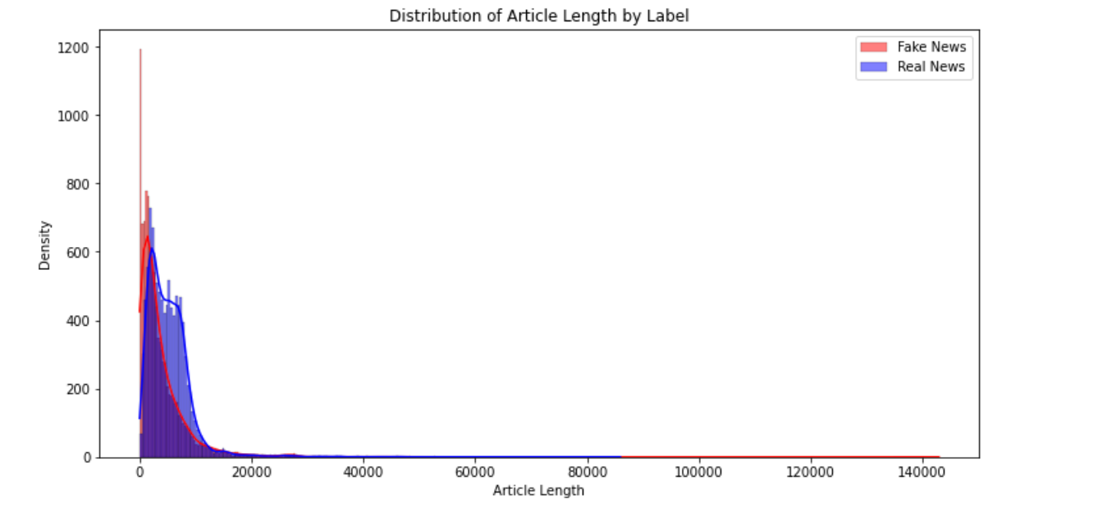
EDA PROCESSING
Full-Length Distribution Analysis
Article Length Distribution Analysis:Conducted to probe potential correlations between article length and authenticity.
Primary Objective:Uncover any discernible patterns in article length aiding in distinguishing fake news from true news.
Key Findings:Majority of articles clustered within the 0 to 20,000-length range.
Lack of Clear Distinction:Distribution did not yield a clear distinction between fake and true news based on length alone.
Need for Further Analysis:Recognized the necessity to delve into additional analytical approaches like machine learning and further visualizations for better comprehension and differentiation between fake and true news.

Slide 6
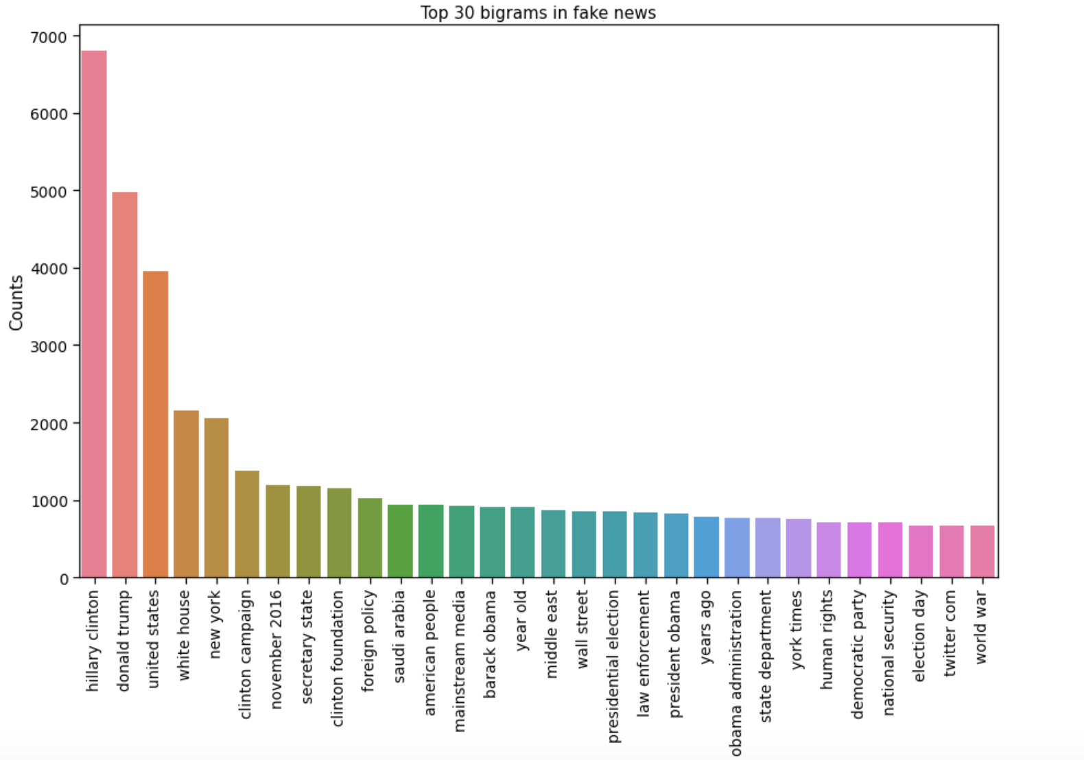
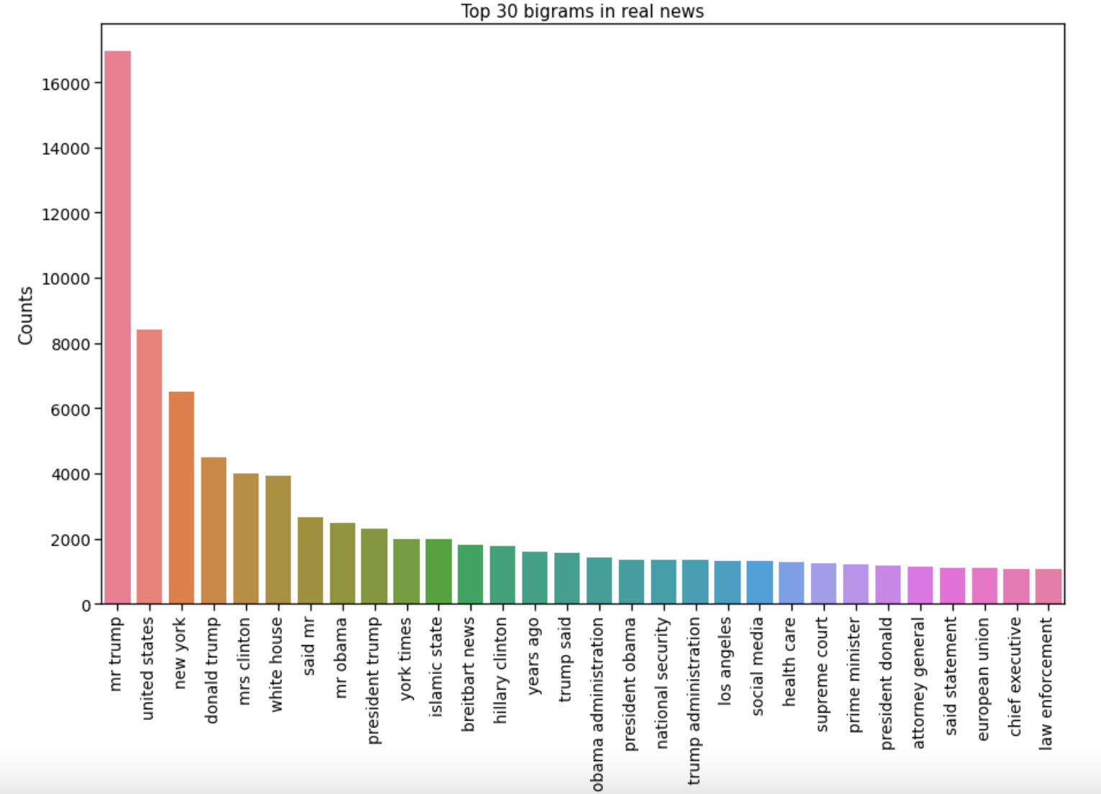
EDA PROCESSING
Bigrams Analysis
Bigram Analysis:Conducted to study the top pairs of words in both fake and real news datasets.
Common Themes:Found both news types frequently discussed similar topics like "Hillary Clinton", "Donald Trump", "United States", "White House", "campaign", and "November".
Similar Big Topics:Both fake and real news stories were centered around major topics, predominantly U.S. politics.
Insufficient Distinction:Mention of these common terms does not provide a clear distinction between fake and real news.
Need for Additional Verification:Highlights the importance of exploring other methods for determining news authenticity and underscores the necessity of fact and source verification.

Slide 7
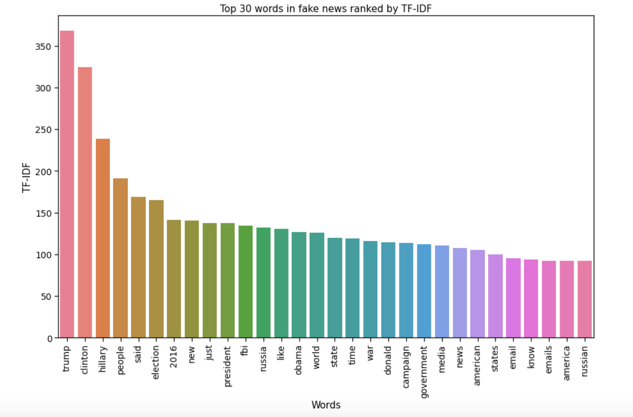
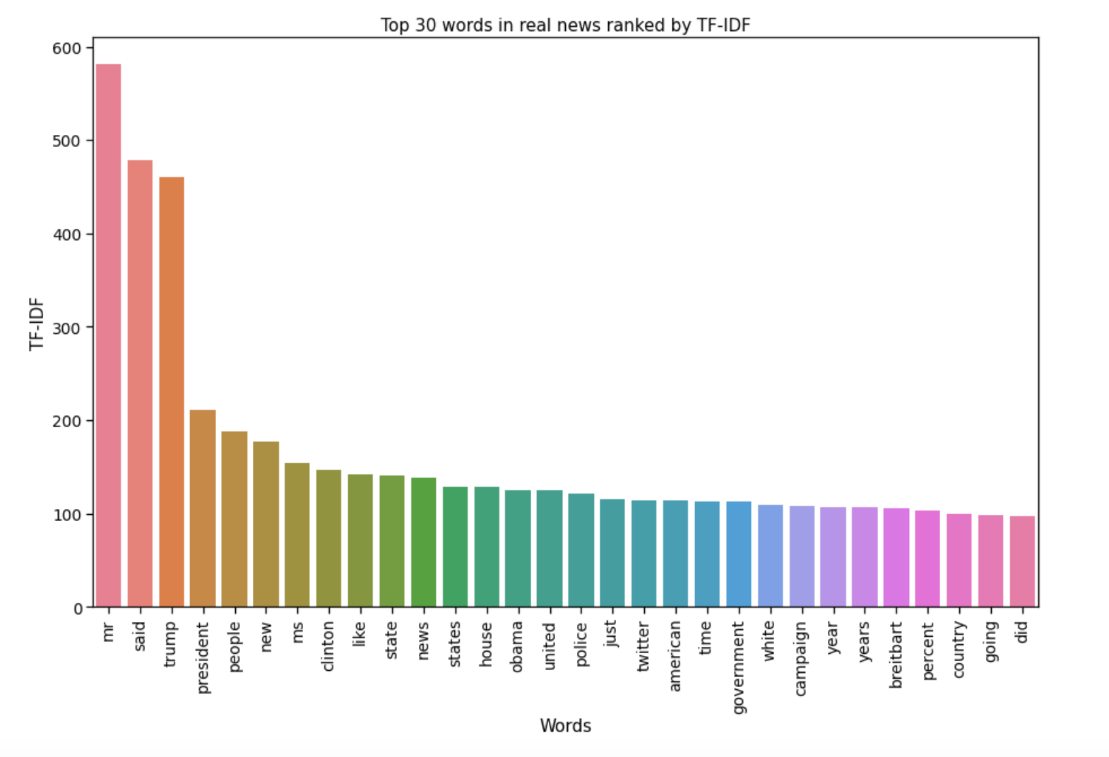
EDA PROCESSING
TF-IDF Analysis
Common Figures Discussed:Both fake and true news prominently featured figures like Trump and Clinton.
Prevalent Topics in Fake News:Words such as "election" and "Hillary" were predominantly found in fake news, possibly indicating prevalent or manipulated narratives.
Potential Underlying Biases:Consistent association of certain words with either fake or true news suggests potential underlying biases.
Indication of Influence Attempts:A heavy focus on terms like "election", "Hillary", and "Trump" in fake news may signify attempts to shape perceptions regarding electoral events.
Insight into Manipulation Tactics:The word associations could provide insight into the tactics used in the fake news domain to influence public opinion.

Slide 8

DATA PRE-PROCESSING AND PARTITIONING
Data Pre-Processing
Custom Preprocessing Class:Designed a NewsPreprocessor class encapsulating preprocessing functions to ensure code modularity and reusability.
Data Partitioning
Train-Test Split:Partitioned the dataset into training and testing subsets using an 80-20 split ratio, ensuring a good balance between training and evaluation.
Text Normalization:Incorporated text normalization steps including removal of non-alphabetic characters, conversion to lowercase, and lemmatization to standardize text data.
Separation of Features and Labels:Isolated the 'content' column as features (X) and the 'label' column as the target variable (y) for both training and testing sets.
Stopword Removal:Utilized Natural Language Toolkit (NLTK) to remove common stopwords, reducing noise in the dataset.
Random State Setting:Set a random state for reproducibility, ensuring that the split yields consistent subsets across different runs.
Lemmatization:Applied lemmatization to consolidate different forms of a word into a base form, enhancing the consistency of text data.
Dask Framework for Efficiency:Leveraged Dask for parallel processing to expedite the preprocessing tasks, crucial given the large dataset.

Slide 9

TEXT TOKENIZER
When dealing with textual data for deep learning or any machine learning models, one of the preliminary steps involves converting this textual data into a numerical format.
Tokenizer Initialization:Initialized with num_words=20000 to retain only the 20,000 most common words, marking others with an out-of-vocabulary token (OOV) to manage rare words and reduce computational complexity.
Tokenizer Fitting:Fitted the tokenizer on training data to create a dictionary-like mapping, associating each unique word with a unique integer based on word frequency.
Text to Sequence Transformation:Converted training and test textual data into sequences of integers, using the dictionary established in the previous step to assign each word its respective integer value.
Padding:Implemented padding to standardize text lengths to a consistent size, as neural networks require input data with uniform dimensions.
Padding Length and Method:Chose the padding length based on the 95th percentile of training data sequence lengths, using the pad_sequences method to append zeros to shorter sequences and truncate longer ones to the specified max_length, ensuring a harmonized input structure for model training.

Slide 10
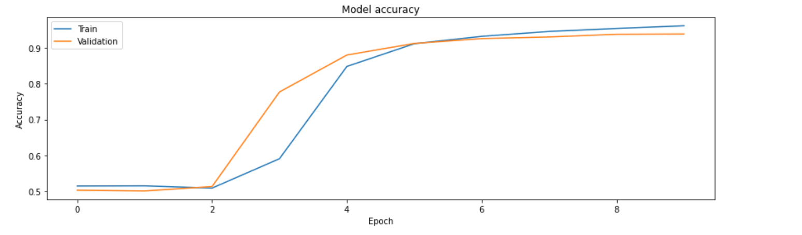
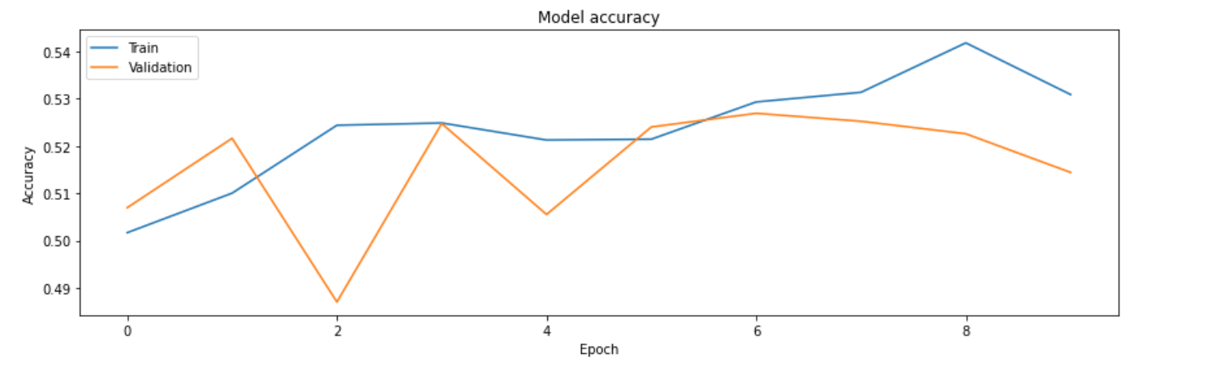
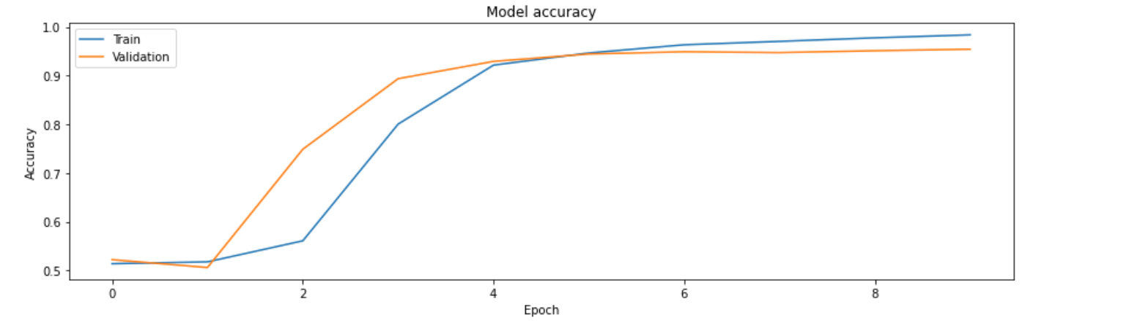
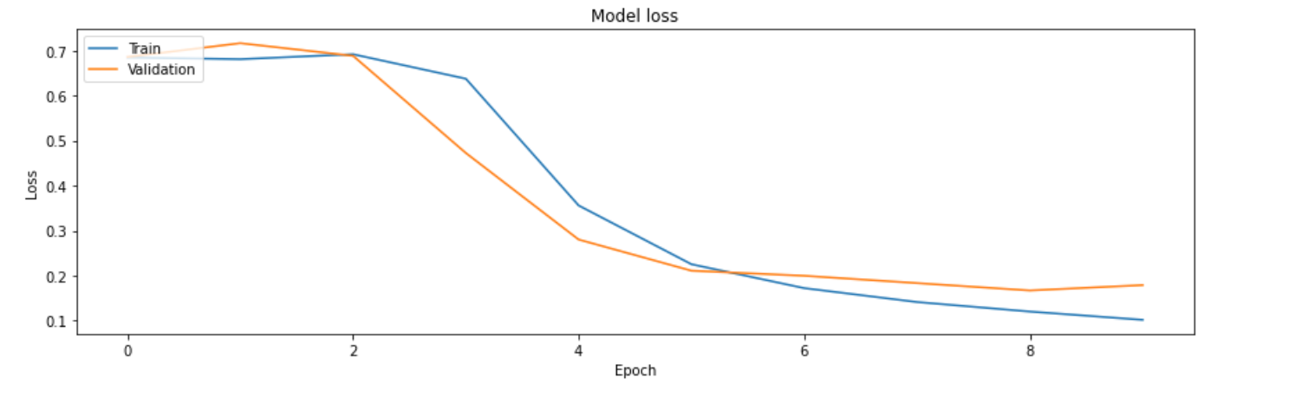
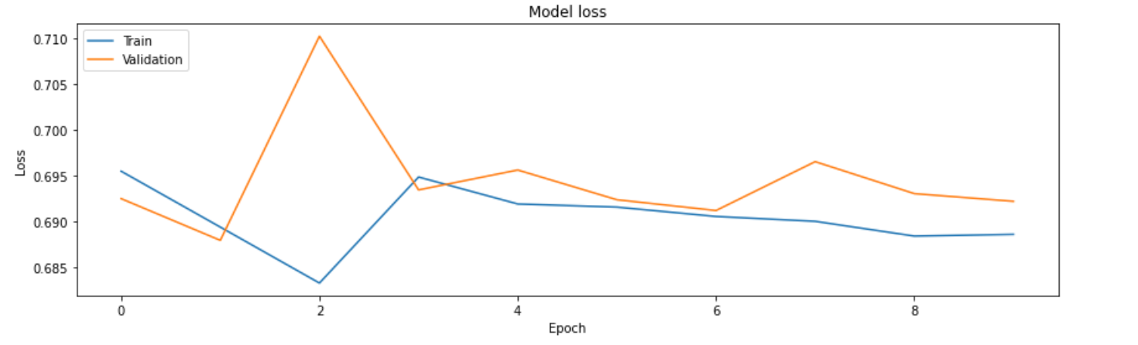
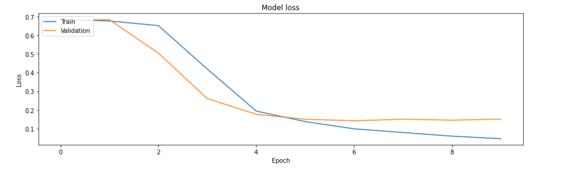
DEEP LEARNING MODELS
RUNNING LSTM NETWORK
RUNNING RNN NETWORK
RUNNING GRU NETWORK

Slide 11
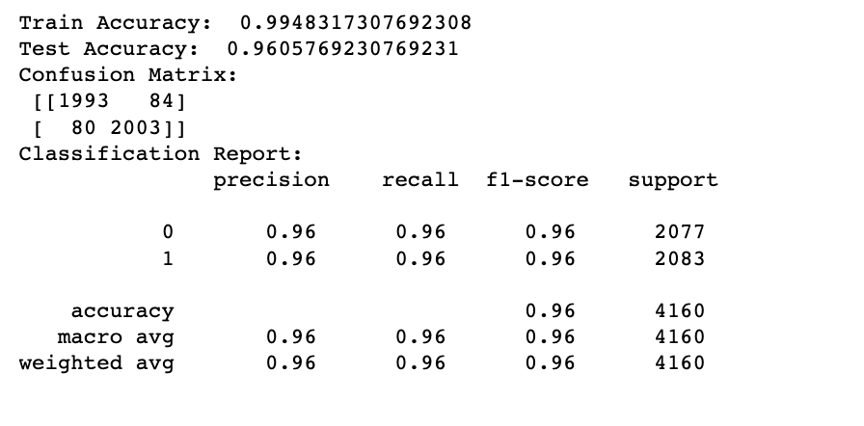
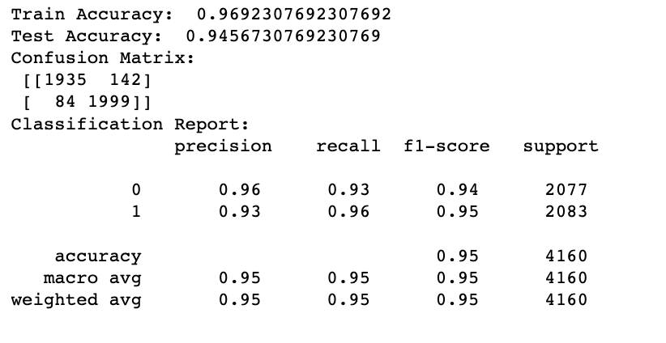
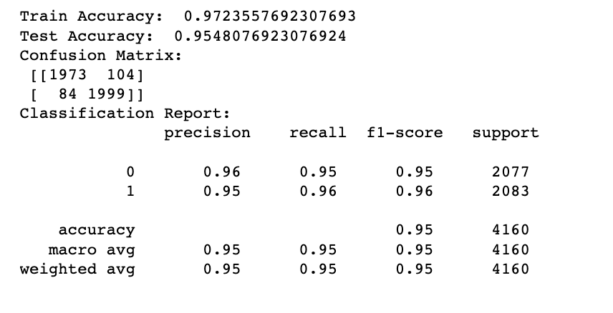
CLASSICAL ALGORITHM MODELS
LOGISTIC REGRESSION
DECISION TREE
SUPPORT VECTOR MACHINE

Slide 12
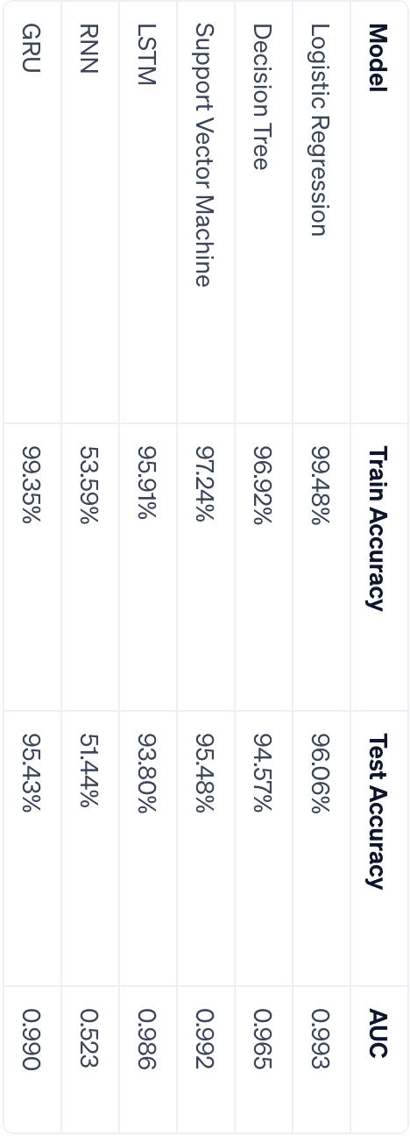
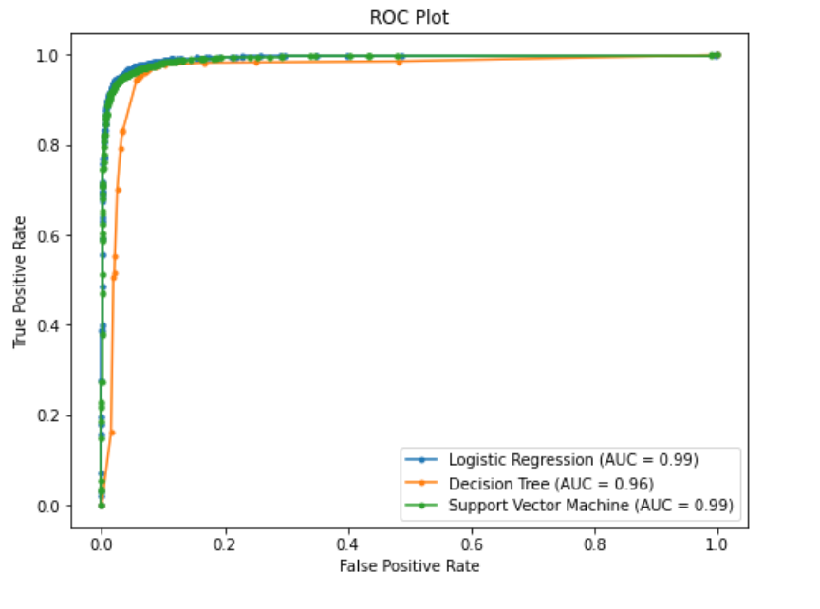
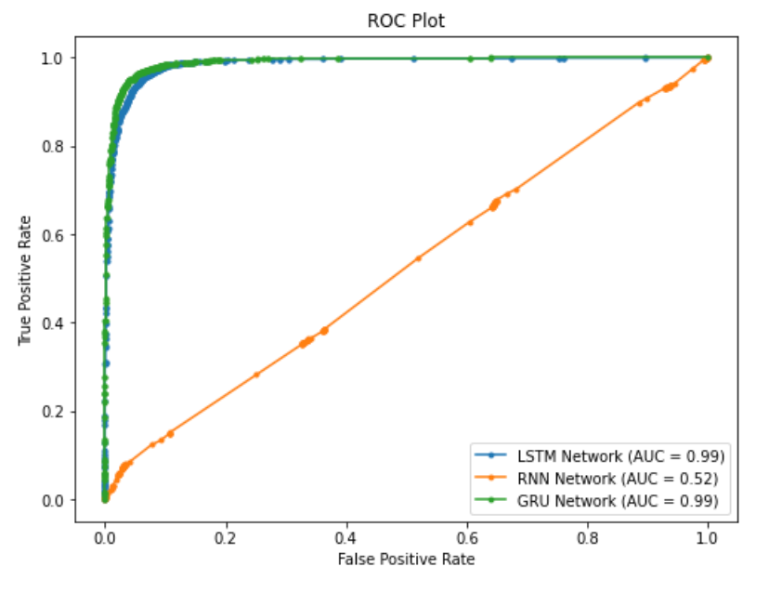
MODEL EVALUATION
Deep Learning Model Evaluation:Utilized accuracy metric to gauge the correctness of predictions by the models.Evaluated model performance further using AUC (Area Under the Curve) and visualized the results through ROC (Receiver Operating Characteristic) curves.
Classical Algorithm Evaluation:Employed confusion matrix to understand the model's performance in terms of false positives and negatives.Assessed models using accuracy, AUC, and visualized the performance through ROC curves to understand the trade-off between sensitivity and specificity.
Model Performance Summary:Among deep learning models, GRU (Gated Recurrent Unit) showcased the best performance with a Test Accuracy of 95.43% and an AUC of 0.990.In classical algorithms, Logistic Regression emerged as the top performer with a Test Accuracy of 96.06% and an AUC of 0.993.

Slide 13
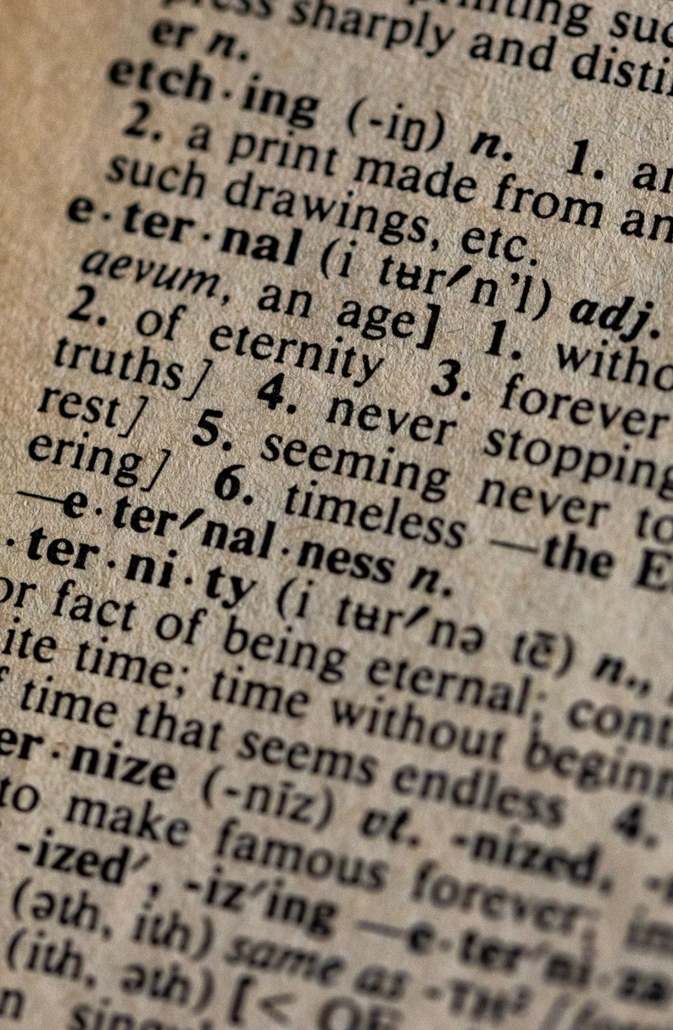
DEEP DIVE INTO TOPIC MODELING
What is Topic Modeling? Topic modeling is indeed a machine learning technique used to discover abstract topics in a collection of documents. It's a way to uncover hidden thematic structures in text data, which can be used for various purposes such as document clustering, organizing large blocks of textual data, information retrieval from unstructured text, and feature selection.
Discovery of Abstract Topics: Uncover hidden thematic structures in text data by grouping recurring keywords into topics.
Dimensionality Reduction: Simplify text data and highlight salient features by grouping similar words, aiding in further analysis.
Documents Clustering: Organize large text collections into meaningful groups for easier navigation and retrieval.
Latent Dirichlet Allocation (LDA): Utilize LDA to probabilistically group words into topics and documents into a mixture of topics, aiding in categorizing text data.
Deploying Topic Modeling to Analyzing News Authenticity and Detect Fake News Themes - Determine the relationship between news topics and authenticity. - Utilize topic modeling to differentiate between 'real' and 'fake' news. - Compare results from a labeled dataset and an unlabeled dataset (Aljazeera). - Identify common themes in 'fake' news for better detection methods.

Slide 14
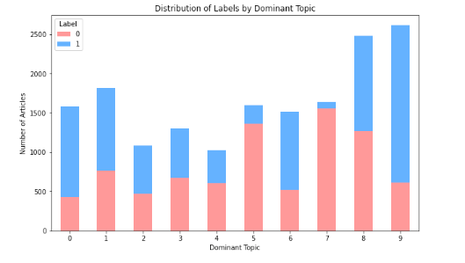
TOPIC MODELING PROCESS FOR LABELED DATA (FAKE NEWS DATASET)
Topic Modeling Steps:
Split the data
Vectorize training data using CounterVectorize
Train our LDA model for training data
Transform our test data
Apply the LDA model for each document in test set

Slide 15
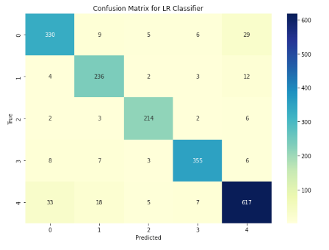
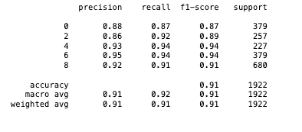
CLASSIFYING DOMINANT TOPICS: A METHODICAL APPROACH
Subset the dataset (using even-numbered dominant topics)
Using different methods to classify dominant topics

Slide 16

ALJAZEERA NEWS WEB SCRAPING
Web Scraping: Conducted web scraping on Al Jazeera news website to fetch daily news articles, utilizing Selenium WebDriver for automated data collection.
Data Preparation: Collected news articles were prepared and structured similarly to the Kaggle dataset used earlier, ensuring consistency in data format for model evaluation.
Model Re-Utilization: Employed the top-performing models previously trained on the Kaggle dataset, notably the GRU model from the deep learning category and Logistic Regression from the classical algorithms category.
Model Evaluation on New Data: Evaluated the models on the newly scraped Al Jazeera news data to ascertain their capability in distinguishing between fake and true news in a real-world, unlabeled dataset scenario.
Readiness for Deployment: With models trained and evaluated, they are now primed for deployment on the Al Jazeera news dataset to automatically classify daily news articles into fake or true categories.

Slide 17
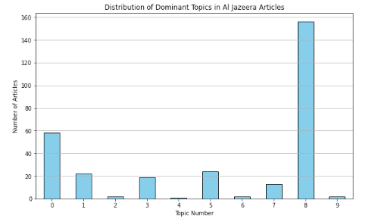
DOMINANT TOPIC DISTRIBUTION IN ALJAZEERA DATA(UNLABELED DATA)
This output shows the distribution of dominant topics for the articles in the news Aljazeera dataset:
Topic 8 seems to be the most dominant, covering 156 documents.
Topic 0 has 58 documents associated with it.
Topics 5 covers 24 documents.
Other topics have fewer documents, suggesting they are less prevalent topics in our corpus.

Slide 18



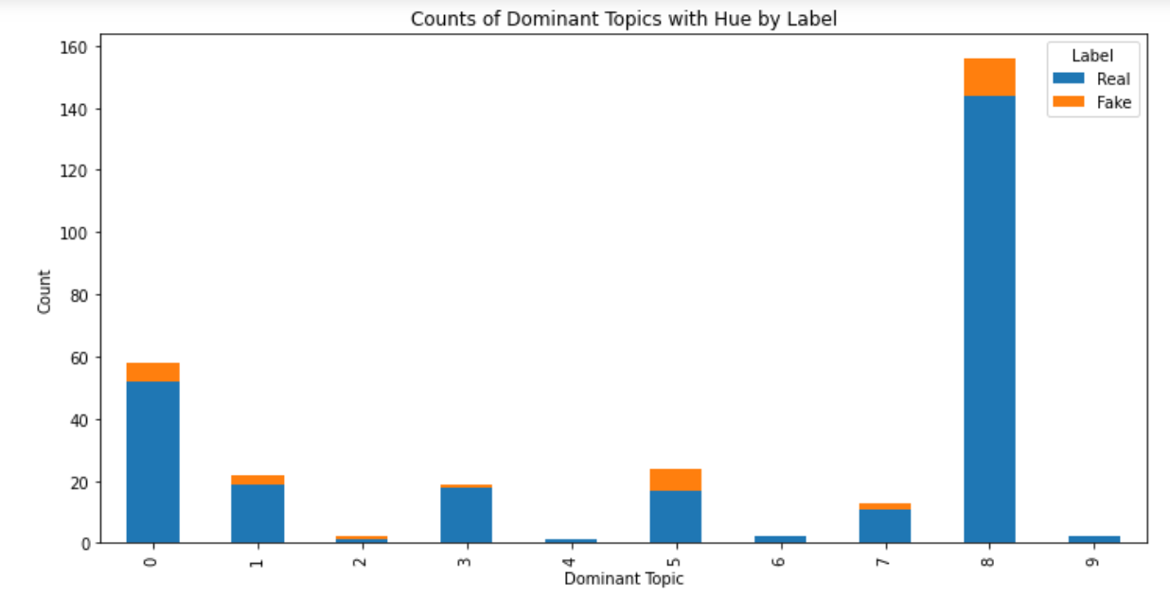
Observation:
Majority of articles in all topics are real, with fewer fake news instances.
Pivotal Insights:
Authenticity isn't driven by the general topic but by the specific content within.
Content Significance:
The truthfulness is tied to the actual language used — words, phrases, and nuances.
Specific linguistic elements are the real indicators of authenticity.
Logistic Regression: Predicting News Authenticity & Analyzing Topic Distribution

Slide 19



Next Steps: Prioritizing Impact & Efficacy
Refine Models: Leverage advanced NLP techniques and incorporate nuanced linguistic features for improved detection accuracy.
Data Expansion: Enrich the dataset with diverse sources and contemporary content to ensure the model understands current linguistic trends and varied narratives.
Real-time Analysis: Develop real-time detection capabilities to promptly identify and mitigate the spread of fake news on digital platforms.
Public Awareness & Education: Initiate educational programs to enhance public discernment of fake news, promoting digital literacy and critical thinking.

Slide 20


OUR TEAM
Mohammad Mahmoudighaznavi
Ruddy Simonpour
mmahmoudighaznavi@sandiego.edu
Ruddys@sandiego.edu

